Slide 1
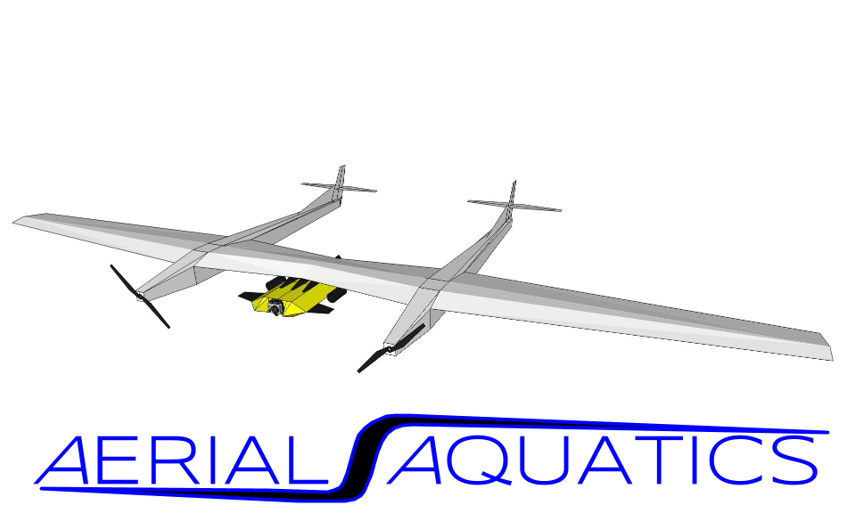
Notes:
Hello, my name is Alex Kuehn and I am a student at Embry-Riddle Aeronautical University. Over the past year I have been working on a project with a fellow NASA Space Grant employee. This project is called Aerial Aquatics.

Slide 2
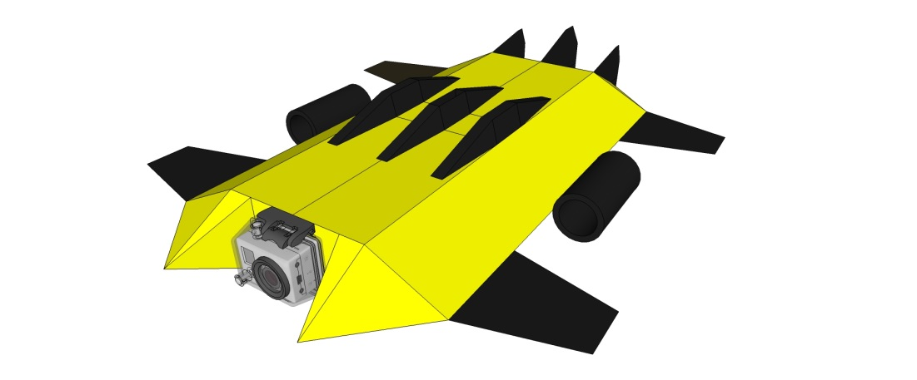
Air & Water: Combined
Submersible Sub-System Utilizing Aerial Mothership
  Submersible Robot
  Carrier Aircraft
Tethered Operations
  Minimal Latency
Extensive Range
  Freedom of Flight
Unprecedented Access
  Remote Lakes
  Inaccessible Locations
Submersible Concept Vehicle*

Slide 3
History

Slide 4
Operations
Land Based
  Landing & Take Off
Water Landing & Take Off
Submersible Robot Deployment
  Winch Mechanism
  Geometric Docking System
Control & Data
  Wired Sub-water
  Aircraft Data Relay Point

Slide 5
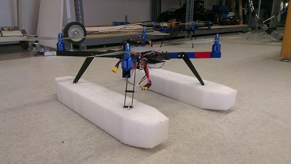
Proof of Concept & Variants of the Configuration
Fixed Wing
Semi-Submersible
  Submersible Camera Carriage System
Aquatic Quad/VTOL
  Submersible Camera Carriage
  Independently Maneuverable Robotic Sub-System

Slide 6
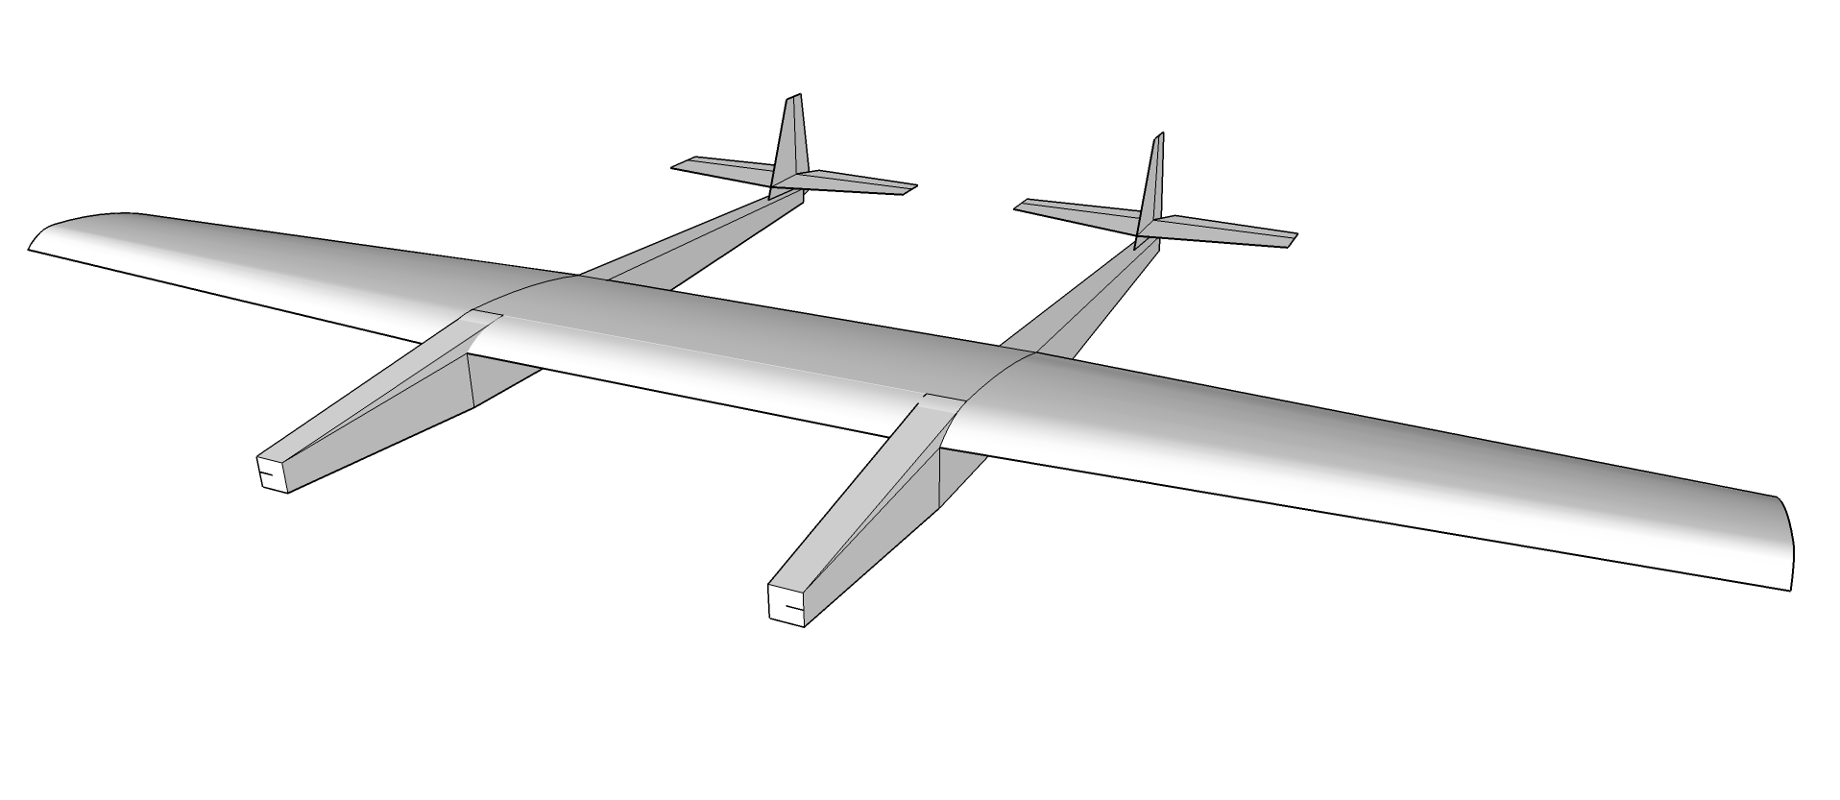
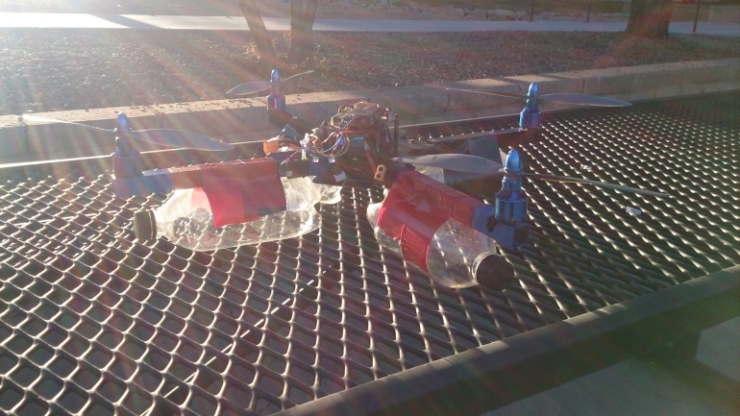
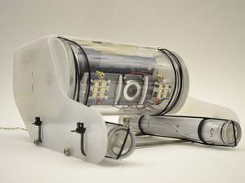
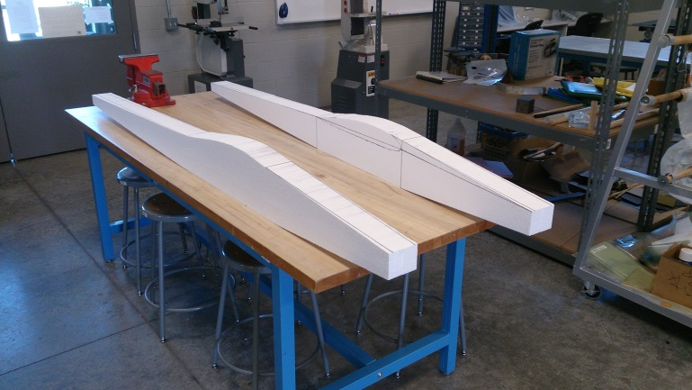
Project Status
Aquatic Quad
  Flight Testing Complete
  Submersible Camera Carriage Complete
  Integrated Testing to Come
Fixed Wing Variant
  Airframe Under Construction
  OpenROV v2.6 Submersible
  Flight Testing as early as May, 2014

Slide 7
Questions?

Slide 8
Thank You

